Slide 1

Good unit test

Slide 2
AGENDA
DAY 1 |  |  | DAY 2
Time | Topic |  | Time | Topic
9:00AM-9:15AM | Program Overview |  | 9:00AM-9:15AM | Recap
9:15AM-9:30AM | Introduction |  | 9:15AM-9:30AM | Team joining break out rooms
9:30AM-10:30AM | Unit Testing Concepts |  | 9:30AM-10:15AM | Authentication Kata Sprint 1
10:30AM-10:40AM | Break |  | 10:15AM-10:30AM | Authentication Kata Sprint 2 Plan
10:40AM-11:00AM | Assertion Walkthrough |  | 10:30AM-11:00AM | Break
11:00AM-12:00PM | Assertion other examples |  | 11:00AM-11:30AM | Authentication Kata Sprint 2
12:00PM-12:15PM | Recap |  | 11:30AM-11:45AM | Authentication Kata Sprint 3 Plan
12:15PM-12:30PM | Authentication Kata Sprint 1 |  | 11:45AM-12:30PM | Authentication Kata Sprint 3
12:30PM-12:45PM | Team Formation |  | 12:30PM-12:45PM | Recap
12:45PM-1:00PM | Day 1 Closure |  | 12:45PM-1:00PM | Workshop End

Slide 3
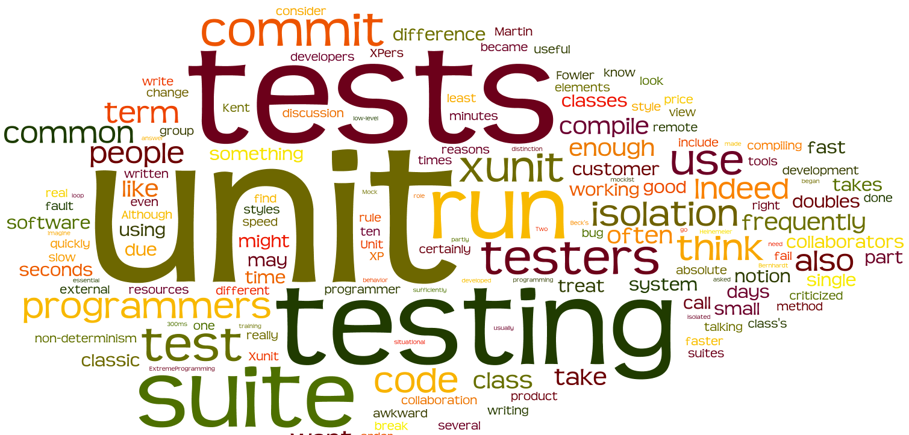

Slide 4

Unit Test
Unit testing is a software development and testing approach in which the smallest testable parts of an application, called units, are individually and independently tested to see if they are operating properly. Unit testing can be done manually but is usually automated.

Slide 5

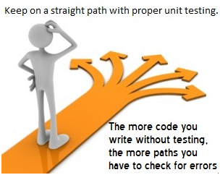
WHY?
Sometimes software developers attempt to save time by doing minimal unit testing. This is a myth because skipping on unit testing leads to higher Defect fixing costs during System Testing, Integration Testing and even Beta Testing after the application is completed. Proper unit testing done during the development stage saves both time and money in the end.

Slide 6
Goal of Unit Testing
The goal of unit testing is to isolate each part of a program and show that the individual parts work correctly.
Unit tests identify issues in the very first stages of the app development cycle. Early resolution of glitches saves an enormous chunk of money down the line.
Unit testing can discover problems well before the app reaches the QA team.
Automated unit testing allows developers to perform refactoring in order to update the software with new features while maintaining design integrity and overall quality.

Slide 7
AAA pattern
Arrange
Objects + Test Data created
Mock setup
Expectation set
Act
Invocation of “Subject under Test”
Assert
Check – Whether Expectations are met
Written in reverse order
Cleanup
Teardown
“Put your toys away” so the next test will start clean.
@Test
public void SalesTaxTest() {
SalesTax salesTax = new SalesTax();
float tax =salesTax.calculate(10.00F);
Assert.assertEquals(1.0, tax, 0.01);
}
Arrange
Act
Assert

Slide 8
SOME ASSERTION STATEMENTS
Category |  | Description
Equality Asserts |  | These methods test whether the two arguments are equal. Overloaded methods are provided for common value types so that languages that don't automatically box values can use them directly.
Type Asserts |  | These methods allow us to make assertions about the type of an object.
Condition Asserts |  | Methods that test a specific condition are named for the condition they test. Eg: Asserting true/false or Null/NotNull etc.
Identity Asserts |  | These methods assert whether same objects are referenced by the two arguments.
Comparisons |  | These methods are used to compare different objects.

Slide 9

Boolean and EQUALITY - Hands ON EXERCISE

Slide 10
F.I.R.S.T.

Slide 11

F FOR fast

Slide 12

I for Isolated

Slide 13

R for Repeatable

Slide 14
Repeatable
Static data or other in-memory constructs not cleaned up
Volatility of external services (e.g. file system, database, web services, API calls)
Non-deterministic behavior due to incorrect use of threads/processes
Dependence on an uninitialized (or slow-initializing) local class
Over-specification (for example, comparing entire screen images or HTML when only a small part of the result is interesting)

Slide 15

S for Self-Verifying

Slide 16

T for Timely, THOROUGH

Slide 17
Test Fixtures
Ensure that there is a well-known and fixed environment in which the tests are run, so that results are repeatable
Setup for Test Suite
Setup for Class
Setup for Unit Test
Unit Test
Teardown for Unit Test
Teardown for Class
Teardown for Test Suite

Slide 18

Patterns

Slide 19
Resulting State Assertion
Make the tests self-checking when there is state to be verified
@Test
public void sizeOfListReflectsItemsAddedToIt() throws Exception {
//Arrange
List<String> list = new ArrayList<String>();
//Act
list.add("something");
//Assert
assertEquals(1, list.size()); // state verification
}

Slide 20
Guard Assertion
Avoid conditional Test logic; replace an “if” statement in test with an assertion that fails the test if not satisfied, rather than resulting in test error
@Test
public void listIsNoLongerEmptyAfterAddingAnItemToIt()
throws Exception {
//Arrange
List<String> list = new ArrayList<String>();
assertTrue(list.isEmpty()); // guard assertion
//Act
list.add("something");
//Assert
assertFalse(list.isEmpty()); // state verification
}

Slide 21
delta Assertion
When we cannot control the initial contents of the fixture; specify assertions based on differences between pre vs. post state of SUT
public class TestAddingToArrayList {
private ArrayList<String> list;
// setup method omitted for brevity
@Test
public void sizeOfListReflectsItemsAddedToIt() throws Exception {
int sizeBefore = list.size(); // record the "before" state
list.add("something");
assertEquals(sizeBefore + 1, list.size());
// delta verification
}
}

Slide 22
Interaction Assertion
Paper Boy
- List<Customer>
+ addToRoute(Customer)
+ deliver(Paper)
Customer
+ onPaperDelivery()
*

Slide 23
Interaction Assertion
public class TestExpectedInteractions {
private List<Customer> delivered;
@Before
public void setup() {
delivered = new ArrayList<Customer>();
}
private class MockCustomer extends Customer {
@Override
public void onPaperDelivery(DailyPaper paper) {
delivered.add(this);
}
}
@Test
public void paperBoyShouldDeliverPapers() throws Exception {
Customer david = new MockCustomer();
Customer esther = new MockCustomer();
PaperBoy paperboy = new PaperBoy();
paperboy.addToRoute(david);
paperboy.addToRoute(esther);
paperboy.deliver(new DailyPaper());
assertTrue(delivered.contains(david);
assertTrue(delivered.contains(esther);
}

Slide 24
References
Agile in a Flash -:Tim Ottinger & Jeff Langr present the blog behind the versatile Pragmatic Programmers reference cards. http://agileinaflash.blogspot.in/2009/02/first.html
https://www.martinfowler.com/articles/mocksArentStubs.html https://github.com/mxunit/mxunit/wiki/What-to-put-in-your-tests-(Assertion-Patterns)
Source: Marcel Douwe Dekker, “Planning and feed back loop in Extreme Programming with time frames”

Slide 25
THANK YOU

Slide 26
SOME ASSERTION STATEMENTS
Category | Description | Some common known Assertions
Equality Asserts | These methods test whether the two arguments are equal. Overloaded methods are provided for common value types so that languages that don't automatically box values can use them directly. | Nunit: Assert.AreEqual( int expected, int actual); Assert.AreNotEqual( int expected, int actual );
Type Asserts | These methods allow us to make assertions about the type of an object. | Nunit: Assert.IsInstanceOfType(Type expected, object actual );
Condition Asserts | Methods that test a specific condition are named for the condition they test. Eg: Asserting true/false or Null/NotNull etc. | Nunit: Assert.IsTrue( bool condition ); Assert.False( bool condition); Assert.IsNull( object anObject ); Assert.IsNotNull( object anObject ); Assert.IsEmpty( string aString ); Assert.IsNotEmpty( string aString );

Slide 27
SOME ASSERTION STATEMENTS
Category | Description | Some common known Assertions
Identity Asserts | These methods assert whether same objects are referenced by the two arguments. | Nunit: Assert.AreSame (object expected, object actual); Assert.AreNotSame; Assert.Contains( object anObject, IList collection );
Comparisons | These methods are used to compare different objects. | NUnit: Assert.Greater( int arg1, int arg2 ); Assert.GreaterOrEqual( int arg1, int arg2) ; Assert.Less( int arg1, int arg2 ); Assert.LessOrEqual( int arg1, int arg2 );

